Slide 1
AGENTIC AI LEADERSHIP PERFORMANCE
PRESENTED BY,
ROHINI SURESH

Slide 2
INTRODUCTION
In today’s rapidly evolving digital landscape, Artificial Intelligence is transforming the way organizations operate and make decisions. One of the most advanced forms of AI is Agentic AI, which has the capability to act autonomously, adapt to dynamic environments, and support leadership-level decision-making.
This presentation focuses on the AgenticAI Leadership Dataset, which provides valuable insights into how AI adoption influences organizational performance, trust, and productivity. By analyzing this dataset, we aim to understand the relationship between AI-driven systems and business outcomes across different industries.

Slide 3
OBJECTIVES
The primary objective of this project is to analyze the impact of Agentic AI on organizational leadership and performance.
This includes:
Understanding how trust in AI affects adoption
Evaluating productivity improvements through AI implementation
Analyzing task success rates across industries
Identifying patterns between AI adoption and performance levels
The goal is to derive meaningful insights that highlight the importance of AI in modern decision-making and organizational growth.

Slide 4
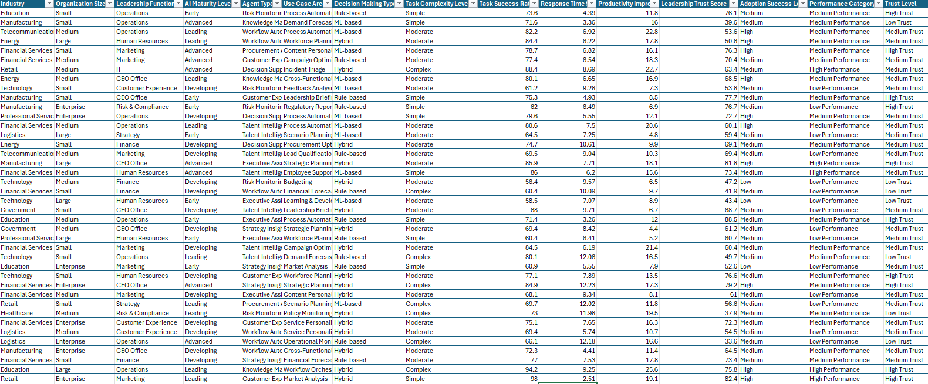
DATASET

Slide 5
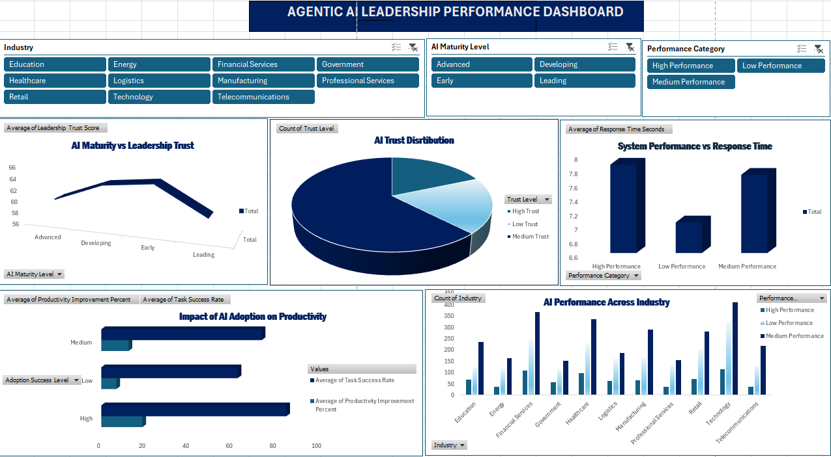

Slide 6
CRITERIA USED
Trust Level
Industry
Performance Category
Adoption Success
Productivity Improvement (%)
Task Success Rate (%)
AI Maturity Level
Response Time

Slide 7
CONCLUSION
In conclusion, this project shows that Agentic AI has a strong impact on how organizations perform and make decisions. The dashboard clearly shows that when organizations trust AI and use it successfully, their productivity and task success rates improve.
It also shows that the impact of AI is different in each industry, depending on how well it is used. Organizations that use AI properly achieve better results.
Overall, this project highlights that trusting and using AI in the right way can improve efficiency, leadership, and business growth. The dashboard helps in understanding these insights and supports better decision-making.

Slide 8
SUGGESTIONS
Implement feedback systems to improve AI performance over time
Use real-time data monitoring for faster decision-making
Ensure data privacy and cybersecurity measures are in place
Promote cross-functional collaboration (IT + business teams)
Conduct regular AI audits to check effectiveness and fairness
Use predictive analytics to improve future decision-making

Slide 9
REFERENCE
• Kaggle : Agentic_AI_leadership Dataset
https://www.kaggle.com

Slide 10
THANK
YOU

